Slide 1

EASC
Development Session
Risk appetite, risk management
Commissioning / regional escalation
23rd July 2019
National Collaborative COMMISSIONING UNIT

Slide 2

Introduction
EASC development session: 23rd July 2019
  EASC hosted by CTMUHB
  CTMUHB Risk Policies & Procedures in place. .
  October 18 CTUHB Audit : assurance required on WHSSC Corporate Risk Framework.
  EASC development session & agreement on proposed approach.

Slide 3
Context & Focus
EASC development session: 23rd July 2019
  EASC Risks: relate to the functioning of the committee.
  Commissioning risks: relate to EASC through the CASC commissioning providers effectively.
  Provider risks: managed through provider risk management process unless tolerance is exceeded.
  Risks applied across, strategic, programme, project & operational levels.
Notes:
EASC Have approved IMTP
Failure to deliver approved IMTP actions
Effective functioning of the committee and its sub committees
Ensuring commissioning arrangements for EASC commissioned services are fit for purpose.
NCCU corporate infrastructure to manage risk

Slide 4
Definitions
EASC development session: 23rd July 2019
  Risk Management
  Systematic application of principles, approach & processes to identify, assess, plan & implement responses.
  Risk Capacity
  The maximum amount of risk EASC are willing to bear.
  Risk Appetite
  The amount of risk EASC is willing to accept.
  Risk Tolerance
  The threshold levels of exposure that with approval can be exceeded but will trigger a response.
Notes:
Source Management of Risk

Slide 5
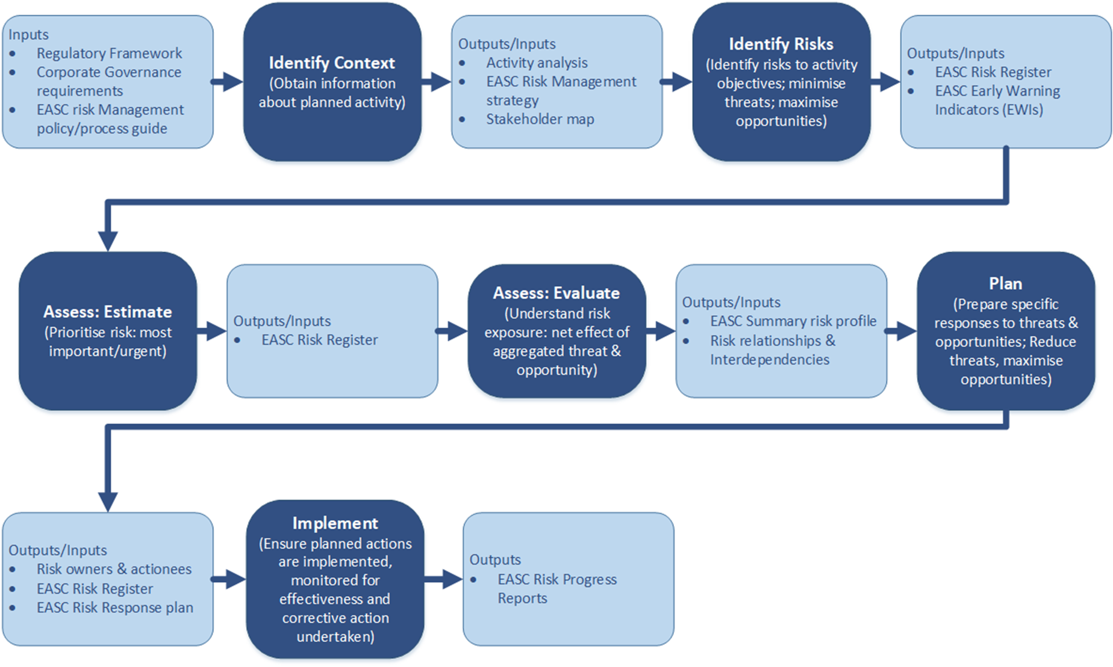
Easc development session 23rd July 2019
Proposed process
Risk appetite, management,
commissioning & regional escalation
Notes:
Outline of the proposed approach
4 Step Cycle:
Identify
Assess
Plan
Implement
Focus of the session Identify Context

Slide 6
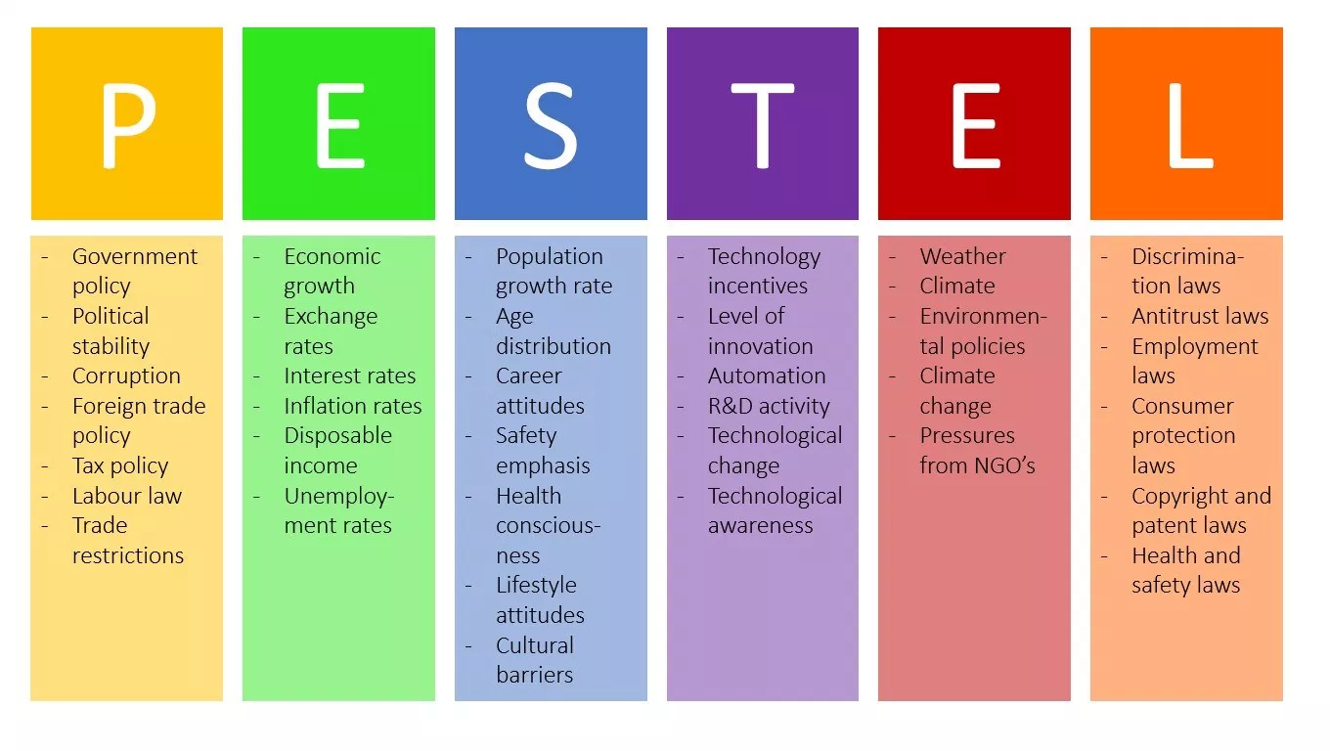
Easc development session 23rd July 2019
Identify the context.
Risk appetite, management,
commissioning & regional escalation
Notes:
Important that EASC Identify and frame the external context and strategic risks.
Political factors
Government stability/instability
Corruption level
Tax policies
Freedom of press
Government regulation and deregulation
Special tariffs
Political action committees
Government involvement in trade unions and agreements
Competition regulation
Voter participation rates
Amount of government protests
Defense expenditures
Level of government subsidies
Bilateral relationships
Import-export regulation/resctrictions
Trade control
Lobbying activities
Size of government budgets
Economic factors
Growth rate
Interest rate
Inflation rate
Exchange rate
Availability of credit
Level of disposable income
Propensity of people to spend
Federal government budget deficits
Gross domestic product trend
Unemployment trend
Stock market trends
Price fluctuations
Social factors
Population size and growth rate
Birth rates
Death rates
Number of mariages
Number of divorces
Immigration and emigration rates
Life expectancy rates
Age distribution
Wealth distribution
Social classes
Per capita income
Family size and structure
Lifestyles
Health consciousness
Average disposable income
Attitude towards government
Attitude towards work
Buying habits
Ethical concerns
Cultural norms and values
Sex roles and distribution
Religion and beliefs
Racial equality
Use of birth control
Education level
Minorities
Crime levels
Attitudes towards saving
Attitude towards investing
Attitudes towards retirement
Attitudes towards leisure time
Attitudes towards product quality
Attitudes towards customer service
Attitudes towards foreign people
Technological factors
Technology incentives
Automation
R&D activity
Technological change
Access to new technology
Level of innovation
Technological awareness
Internet infrastructure
Communication infrastructure
Life cycle of technology
Environmental factors
Weather
Climate
Environmental policies
Climate change
Pressures from NGO’s
Natural disasters
Air and water pollution
Recycling standards
Attitudes towards green products
Support for renewable energy
Legal factors
Discrimination laws
Antitrust laws
Employment laws
Consumer protection laws
Copyright and patent laws
Health and safety laws
Education laws
Consumer protection laws
Data protection laws

Slide 7
Easc development session 23rd July 2019
Determining Risk Appetite
Where should EASC allocate their limited time and resources to minimise risk exposures? Why?
What level of risk exposure requires immediate action? Why?
What level of risk requires a formal response strategy to mitigate the potentially material impact? Why?
What events have occurred in the past, and at what level were they managed? Why?
Risk appetite, management,
commissioning & regional escalation
Notes:
There are various drivers that may cause you to look at setting risk appetite including:
• Recommendations from an external audit
• Setting and implementing strategic plans
• The need to manage IMTP deliverables

